Slide 1
Supporting the developer’s experience with production metrics
A framework for actionable feedback-driven development
Norbert Podsadowski
Notes:
Hello
I will be presenting a framework for supporting the developer’s experience using collected metrics from running production applications

Slide 2
Modern development landscape
Notes:
First, I want to talk a little bit about the modern development landscape. Many of you will be familiar with these concepts, but it’s important to pay attention to why some of these concepts serve as prerequisites to creating the tools proposed in this project.
Arguably, the most notable change is the transformation from the classical model of software development into the modern model of "agile" development. Businesses have realised the benefits of developing software in a very incremental, cyclic fashion.
Any tech company with a modern approach to development rolls out features using a process which became known as continuous delivery. New features are made available immediately after work on them completes, to the end-users who begin actively interacting with the new system. This allows data on how successful a particular release was, to be collected immediately after the release, which can happen even multiple times per day.
These changes are tightly coupled with the emergence of Software as a Service. Not only are software upgrades released on a daily basis, but they are released to a single coherent logical view of the application which all end users interact with. This increases the sheer volume of data that we can collect as a result.
Another changing trend is the proliferation of the DevOps movement, which blurs the boundaries between developing and operating software. Historically, a software company might have a dedicated team, whose job it is to monitor any issues which arise on the production system. However, in the most frequent cases, these issues are rooted in either performance or correctness regressions that only the development team has the power to change. So, people soon realised that it’s much more effective to replace such operations teams with simply more developers, who now have the job of not only developing the code, but also making sure that it’s always running correctly, 24 hours of the day, as is demanded by the modern, technology-driven economy.
The last change I want to highlight is the proliferation of microservice architectures, typically hosted on the cloud. Software teams have realized the benefits of writing and deploying applications as a series of small, independent microservices that encapsulate a small portion of logic, as this greatly helps with code quality, elasticity, modularity and all the various things common to good software. The interface to these microservices tends to be RESTful APIs, served over HTTP, which will become important later.
- Move fast and break things

Slide 3
Software as a Service
=> Single logical application instance, wealth of production metrics
Agile & Continuous Delivery
=> Collect many changing versions of production metrics data
DevOps
=> The need to utilize operations data during development
Notes:
To reiterate:
Software as a service provides a channel for every single one of our end-users to interact with a single logical instance of our running software that we are always completely in control of, and enable a continuous stream of large volumes of production metrics
Continuous delivery and short, very frequent release cycles allow for many versions of such production metrics that exist
And the emergence of DevOps justifies the need to bring operations data closer to developers

Slide 4
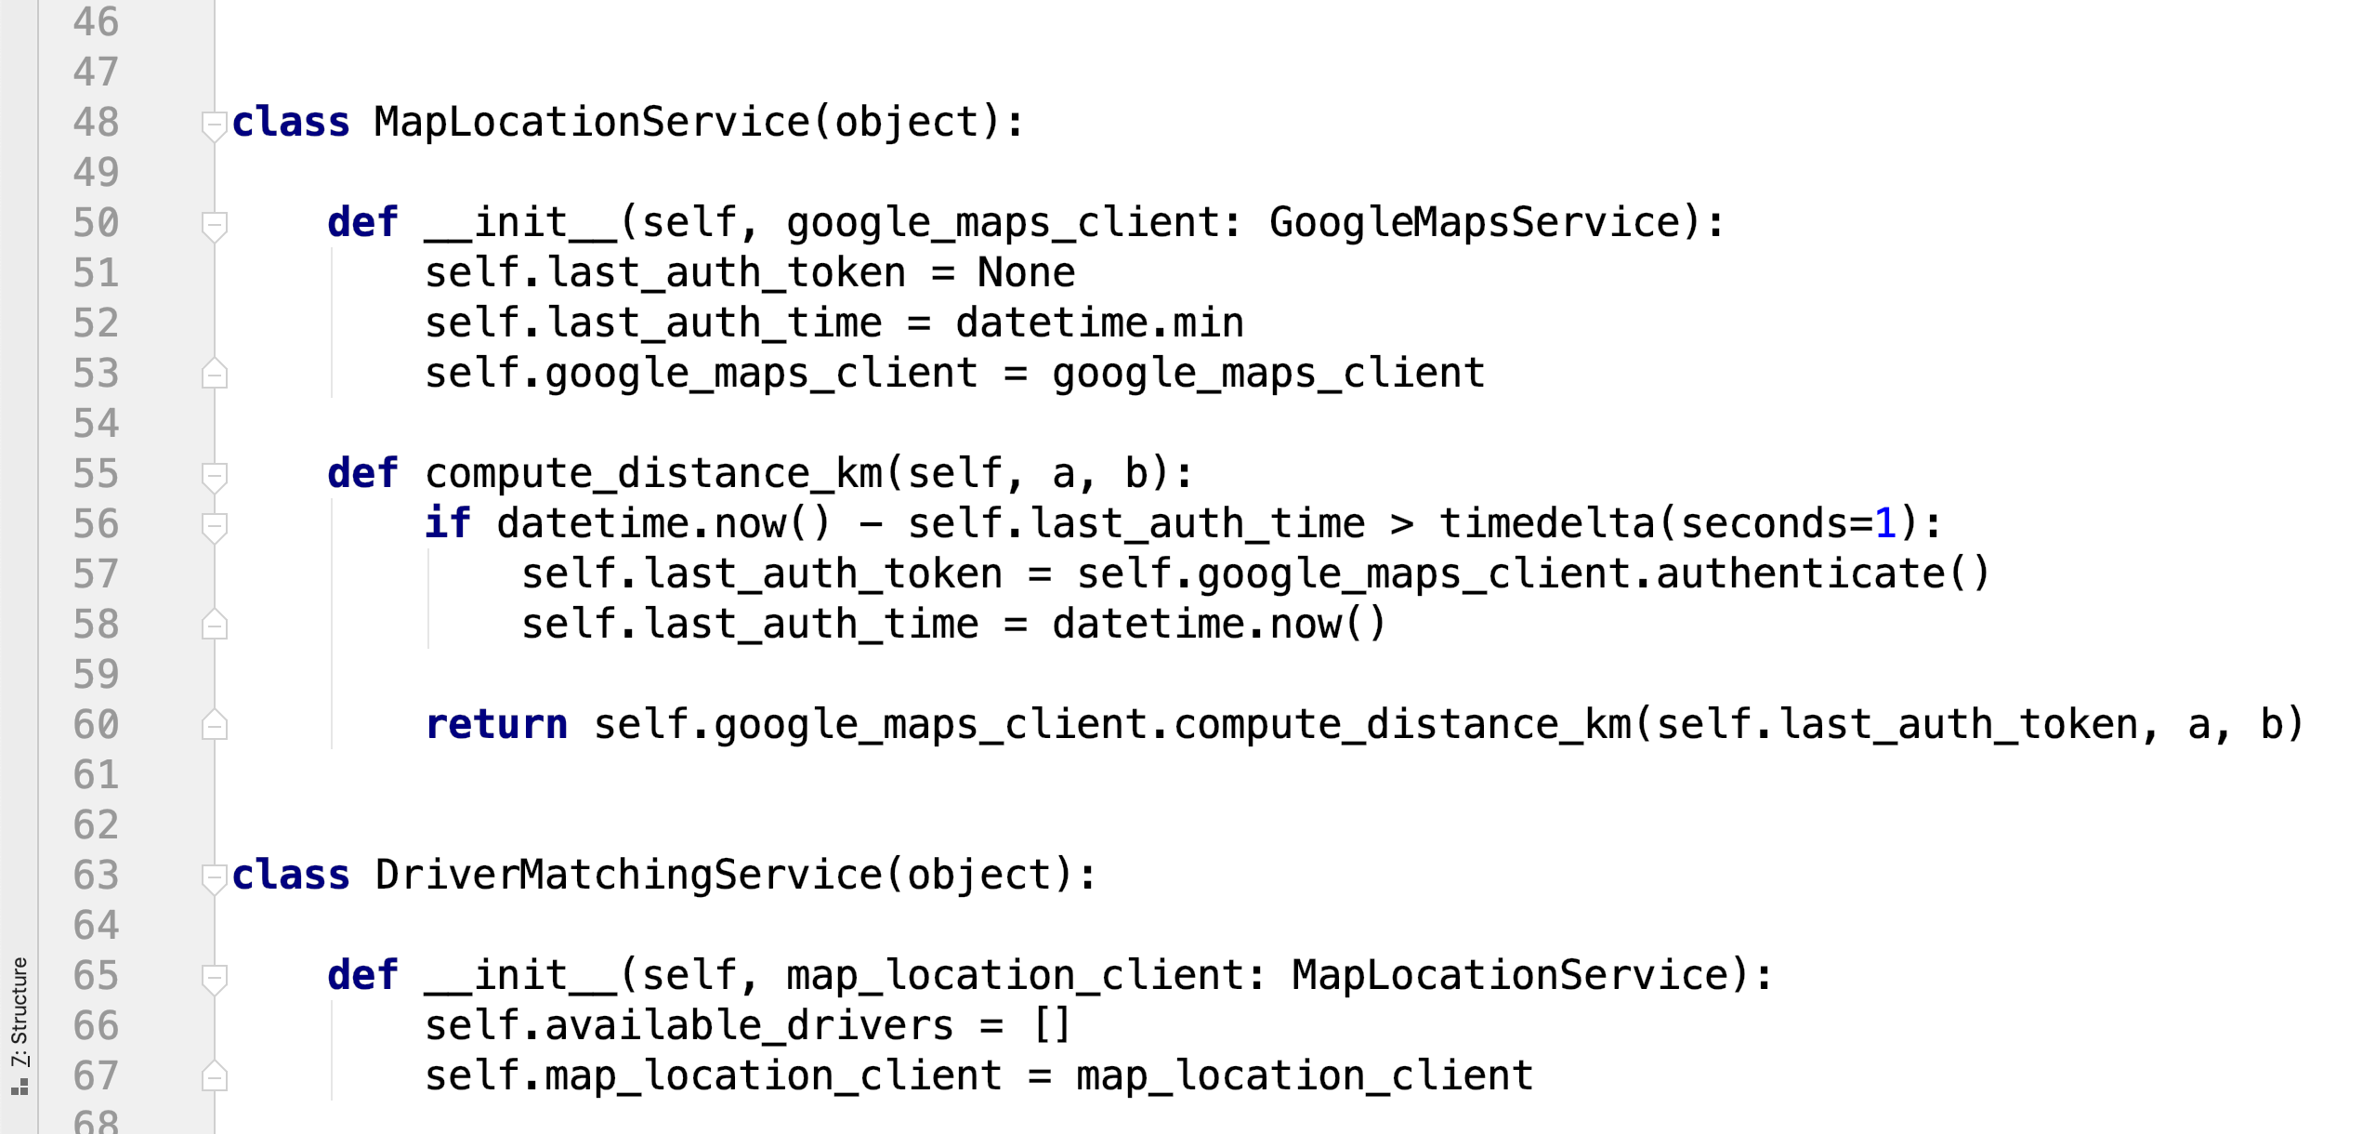
Development
Notes:
This is what development currently looks like. You have a developer sitting in front of an IDE, writing code. This is how new features are developed, and this is also how performance and correctness issues get fixed, when such issues arise.

Slide 5
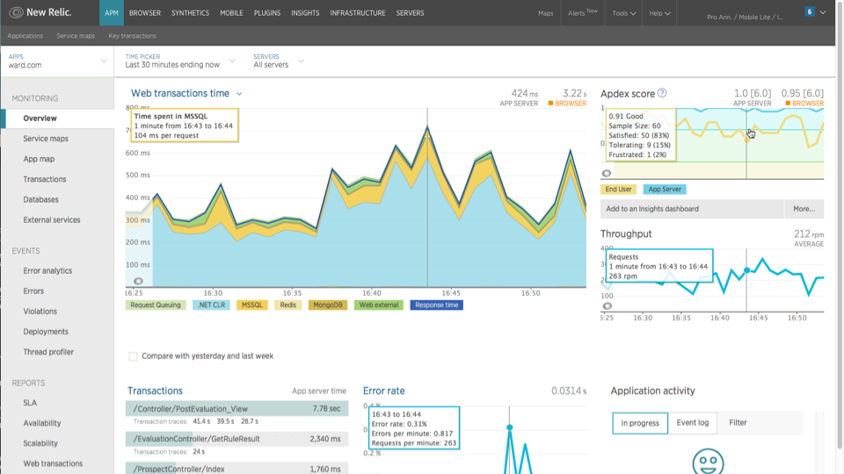
Operations
Notes:
This is what operations currently looks like. This is a screenshot showing a typical dashboard of an application performance monitoring tool, which is the most common place that you might find production metrics being used. By production metrics, we mean data collectable from applications that are currently running somewhere and serving end users, such as high level graphs showing the response times of individual endpoints, graphs showing exceptions rates, or maybe an aggregation of logs from a series of log files, etc.
Research shows that these types of external dashboards are not actionable to developers. What do we mean by not actionable? We mean that that production metrics conveyed in this way are not something that developers can use in a meaningful way during their development work.
This is because of a few reasons:
The first is that such dashboards usually show, high-level, coarse grained information that does not easily map onto the individual code lines that developers care about
This information is not automatically versioned, in the way that developers understand using version control. As a result, they also tend to focus primarily on the most recent state.
These tools are simply not designed to help developers during regular software maintenance tasks, and served their purpose in the pre DevOps world where operations teams were still commonplace, who would use these tools to flag up issues for developers, who will then use other mean to uncover the true root causes of arising problems.

Slide 6
Notes:
In order to illustrate this, imagine that you work in a small team of developers in a small-scale private cab hire startup, such as Uber or Lyft.
Your systems consist of a mobile app for customers, a mobile app for drivers, and a series of microservices that you host in the cloud. Each such microservice is responsible for a small, well-defined portion of logic.

Slide 7
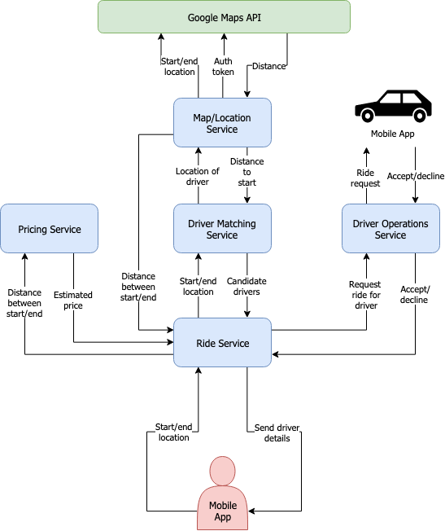
Notes:
This is what such an architecture might look like.
A customer chooses a start location and an end location on a mobile app, and taps Request Ride, and sends this information to the Ride Service
The ride service sends the start and end location to the pricing service and asks for a price estimate of this ride, which it soon gets back
The ride service sends the start and end location to the driver matching service and gets a list of candidate drivers, which the matching service sorts based on criteria such as proximity to the start location and the rating of the driver
The ride service will then go down that list of candidates and requests rides from drivers, who are gonna be notified about the request. It’s gonna keep doing that until it either runs out of candidates or somebody accepts the ride
The pricing service and the driver matching services both use the map/location service that compute distances between two points
And map/location service in turn uses the Google Maps API, which requires the points a and b as well as some form of authentication token
Eventually, the customer’s mobile app gets notified of the driver that’s accepted their ride, or if nobody was found, the user interface displays an error of some sort.
So this is the typical set up of a application built using a microservice architecture. Each service has a well-defined role and provides its functionality through a REST API served over HTTP.

Slide 8
Notes:
Now lets pretend that you come into the office in the morning, and you find out from your boss that your customers have been complaining about having to wait a very long time for the app to respond to ride requests. The interface is freezing up and overall they’re getting a pretty bad experience.
What do you do next? You might fire up the IDE in order to identify the change which introduced this performance regression. The operations team may have given you an initial hint as to which microservices as responding slowly, but not much more than that. So you decide to launch some mocked-up instances of the affected services and run a profiler to see if you can pinpoint the root cause of the performance regression. Unfortunately, the local instances you run are far from the truth. Your profiler doesn’t pick up anything out-of-the-ordinary — certainly not anything that your extensive test suite wouldn’t have picked up. And that makes sense, because how close is your local environment going to be to this full-blown environment that the production instances run on: your key interactions with with third party services are mocked-out, there are big differences in configuration, hardware, etc? The point is — no matter how much you try, your application will never behave in the same way as it does in a production environment, making issues like this a lot harder to debug.

Slide 9
Feedback-Driven Development
Notes:
We believe that there is currently a need to improve this situation somewhat. We state the core problem: Production metrics have not been pushed to the appropriate level of abstraction for developers to utilize them during software development tasks. In order to solve this problem, we want to bring in metrics collected in production, and present them in an IDE-based tool, in a way which is developer-centric and actionable. This gives rise to what we call feedback-driven development.
*DEMO BREAK*
Set-up:
IDE running on local instance CI window available to switch to
Metric backend and application running on imperial VM
Request simulator running locally sending requests to the application
Enough requests in database to demonstrate that there exists a regression problem
No feedback showing initially, Production Feedback toolbar is minimised
So this is our plain, vanilla IDE, where we currently see just code. What we are currently looking at is the find_ride function inside our Ride Service which responds to requests from the customer’s mobile app.
It does exactly what I’ve described before. It first contacts the Map/Location service to get a distance measure between the start and end location
It then gives that distance to the pricing service to estimate a price for the ride.
It gets a list of driver candidates using the driver matching service
It traverses these candidates from the top down, using the driver operations service to ask drivers for rides.
If no drivers accept from the list of drivers, it throws an exception.
It it does find a driver, then logs the number of drivers which declined before a ride was found.
It then send the customer on their by creating the ride with the driver operations service and returns a JSON response to the mobile app
Now watch what happens when I go down to this newly created Production Feedback toolbar
I can set an auto refresh interval of, let’s say, 5 seconds
And then I click on this red bulb here. This overlays a live feed of production metrics feedback directly over my individual code lines. The gutter on the left displays some immediate information which we might care about. The line colors here represent their execution time compared with the rest of the enclosing function. For example, we can see that this distance computation call is taking on average, across all requests, about 2 seconds. Finding candidates takes 3 seconds. Etc.
We can see here that the plugin is telling us that X exceptions have been thrown on this line, and we can hover over this line to get some details. If we go over to the exceptions tab, we can see the exact time the exceptions were thrown, the type of the exception and the message. And this gets displayed all the way up the stack of calls until we get to this line. So what can we use this for? Well, we are trying to investigate this performance issue that we’re having. And maybe one clue that would help us discover this issue is seeing this exception occurring an abnormal number of times. For example, if we saw messages like 0 drivers declined ride, then that means might indicate an issue with our driver candidate matching logic.
Similarly, we can see that there are 5 logging records present on this particular logging line. We can hover over this to see the exact logging calls which occurred. If we saw that there was an abnormally large number of drivers declining the rides, then that could also indicate an issue with our code, or perhaps a a more high-level issue surrounding the actual business context that we’re operating in. In this case, the number of drivers declining seems pretty normal, so we keep investigating.
We can see that these two calls are taking a fairly significant amount of time. If we hover over them, we can get a per-line performance history, which updates in real-time as new requests from rides arrive at our application. And you can see that there’s a spike here: we used to take something like 100ms on average across all requests, and now we’re taking 2 seconds. This is also the case with the find driver candidates call which also uses the map location service. So maybe this indicates a performance issue at the map location service? Let’s find out.
I’ve now jumped to this Map Location service code. It simply takes two points a and b, and forwards them to the Google Maps API in order to get a distance. However, before we can do that, we have to authenticate with the Google Maps API. And we can see that call takes 4 seconds on average, which is quite expensive. And you can see that whoever wrote this service didn’t want to pay that 4 seconds on every request, and so they’ve created a simple cache that re-authenticates the service every hour. However, the IDE plugin tells us that we execute this if statement 100% of the time. That doesn’t seem quite right, because the point of the caching was to only execute this once an hour, so most requests shouldn’t need to pay this 4ms authentication request. But look, this timedelta here is taking a seconds argument, instead of an hours argument. If we look at the difference between this version of the code and the previous deployment, we can actually see that someone sloppily changed this hours argument to a seconds argument, which meant that we were no longer caching the authentication token for long enough, and most requests were paying this 4 second cost.
So we can actually revert that commit, by changing the seconds back to hours. We can also add a logging call that will tell us when this authentication is happening. *commit* So before I commit this change, watch what happens to these text indicators on the left here. And as soon as we push, we can see that these indicators change to italic text. This indicates the fact that the version of the code we’re , currently looking at is stale. Stale means that its displaying old feedback from a previous version. We can also see this if we hover over this line and look at this status indicator: It says stale, checked-out version is greater than the instrumented version, so we should wait for the build to complete and the new version to deploy in order to correctly interpret these metrics.
And as soon as the build finishes, which should happen very soon, our customers will immediately start interacting with the newly deployed version of the application. This will stream new data directly into our IDE, and we’re going to be able to immediately see the effects of our changes, originating from the real production environment. Watch what happens to this branch execution probability indicator: Its very quickly going down to a small percentage. We can see that this logging call has been executed only once. Hopefully, this will last for the duration of a whole hour this time. We can also open up this regressions & improvements tab, which will tell us how the new deployment has affected the individual lines of code in this file. Under the improvements list, we’re able to see that lines X, X and X have experienced a significant improvement in mean execution time. If we click on this, we get taken to the exact line in question. This is back in the overall ride service code which glues everything together. If we hover over this, we can see that all requests coming in after the new version indicator are significantly faster that before. We are thus confident, that the performance issue customers have been reporting has indeed been fixed.

Slide 10
Approach
Request-centric
Short-lived
Well-defined start and end
Line-centric
Minimal setup
Notes:
Let’s talk a little bit about how this was built
So there are three main ideas behind the approach we’ve taken: we are targeting RESTful APIs, where the primary unit of work is a single request. Due to the nature of such APIs, these requests will likely be short-lived (under 60 seconds, the typical timeout for HTTP requests) and have a well-defined start and end. Such requests represent a single execution trace through the entire application, and many such traces will exist during the course of its uptime. This single trace becomes a first-class citizen of the entire feedback framework, and we associate all of our collected metrics with such a single request. Also, the abundance and short-liveness of such requests allows the feedback system to learn from a constant feed of data when users and other microservices regularly interact with the instrumented microservice.
Our approach is also line centric, which means that all of the production metrics we collect can be associated with a particular line of code.
We also require a minimum-setup: adding a new application to this framework simply involves creating a very short config file and adding a single line of code to your app’s initialization module

Slide 11
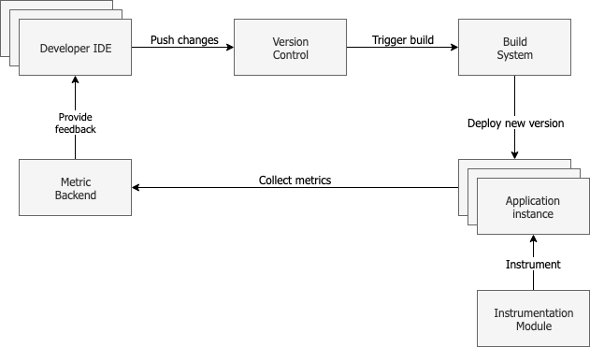
Notes:
This is a typical deployment pipeline.
We have a developer sitting at his desk, making code changes using an IDE. These changes are pushed to version control, which triggers a build inside our build system. The last stage of any build pipeline is the deployment step, which uploads the new binaries to the cloud and deploys a new version of our application. There is an instrumentation module which sits on top of the application instance and collects various metrics such as performance, exceptions and logs. These metrics are sent to a metric backend, which persists those metrics to the database after doing the necessary processing. It then provides a processed view of these metrics to the IDE, which displays them inside the user interface.
This essentially creates a continuous feedback loop, where developers are given actionable information on every code change they decide to push into production.

Slide 12
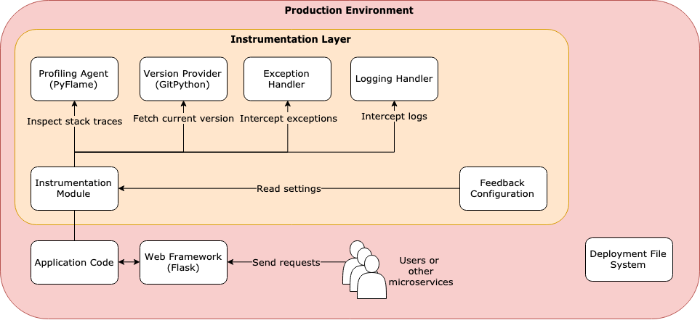
Notes:
Zooming in a little bit, this is what our production environment looks like. During the initialization of the web framework, the developer is required to insert a single line of code that hooks in an instrumentation layer. This instrumentation layer then installs a custom exception handler, a custom logging handler, and handles the start up and shut-down of a low-overhead sampling profiler that collects performance information. It also uses a version provider to fetch the current commit hash ID of the application, and tags all collected metrics with this commit hash.

Slide 13
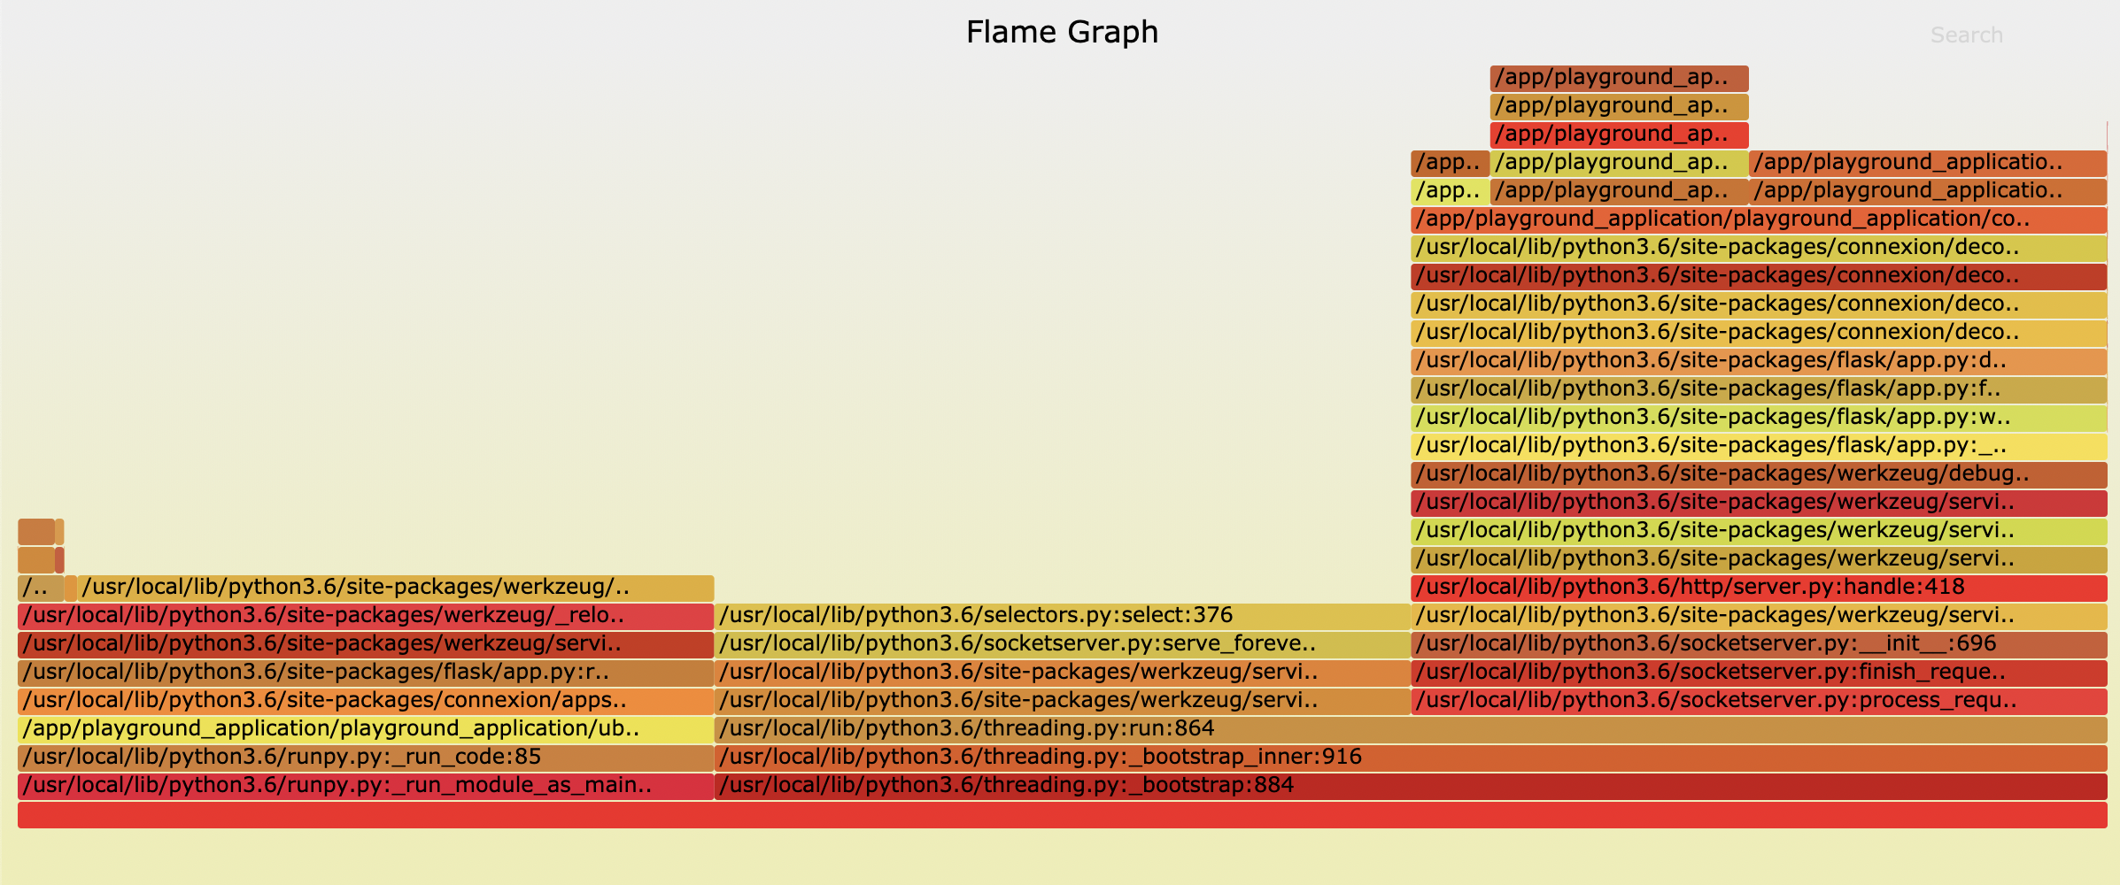
Performance instrumentation
PyFlame
Notes:
In order to collect performance information, we run a low-overhead sampling profiler called PyFlame that collects samples of stack traces currently seen in every executing thread of the application. It pauses the Python application every X amount of seconds, inspects the current stack trace held by the executing program, and it counts the amount of times that it has seen a particular stack trace, returning a total count for each stack trace it encountered. It does this using ptrace. We then isolate the thread which is used to serve the actual request which arrived at the application in order to make all sample counts relative to that thread only, which allows it to estimate the per-line execution times of our program.
The challenges here were figuring out how to properly run this profiler at the beginning of every request, and then gracefully tear it down at the end, capturing all of its textual output, parsing it and making correct estimations of performance within the profiled application. We also had to handle a variety of different edge cases, such as what happens if the program terminates unexpectedly during execution – we don’t want to leave a zombie profiler hanging around, for example.

Slide 14
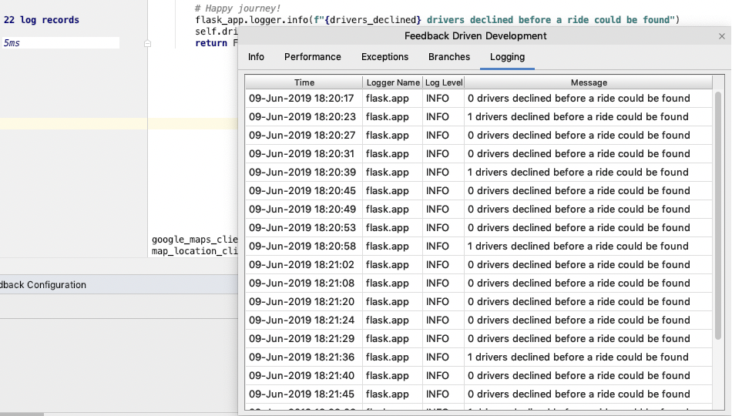
Exceptions & Logging
Notes:
Then, I added support for exceptions and logging, which hook into…. Blah

Slide 15
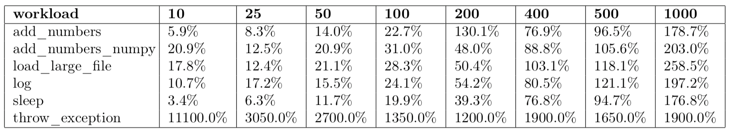
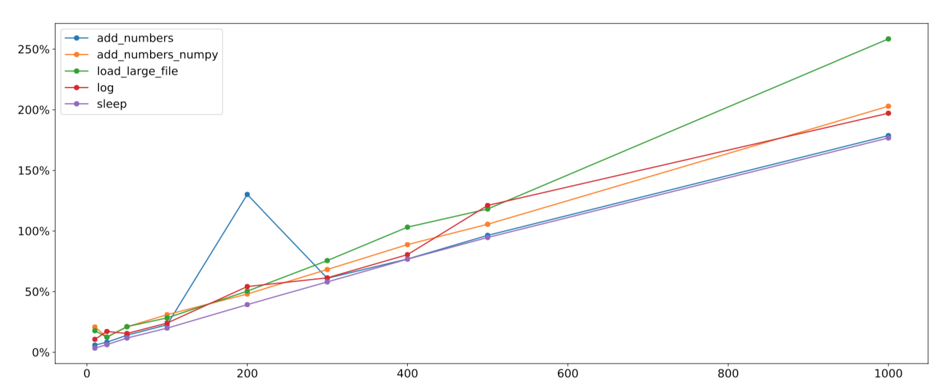
Overheads
Notes:
I conducted an investigation into what kinds of overhead our instrumentation module has on different types of workloads.
I created 6 different workloads, some of them I/O bound and some of the CPU bound.
The CPU bound ones were add_numbers which simply added numbers 1 to n sequentially using python, add_numbers_numpy which did some similar number crunching using a fast numerical library called Numpy.
The I/O bound ones were load_large_file which loaded half a million CSV rows, log which logged to the console 10,000 times, sleep which slept for 3 seconds, and throw exception which just immediately threw an exception
There were two types of overhead here: inside the actual controller function that serves the request, and outside the controller function. The overheads outside the controller function were due a fixed 30-45ms cost which is how long it takes to start and then later tear down the profiler. This is why the throw_exception relative overhead is so high, because that endpoint normally finishes in something like a millisecond. This overhead could be optmised away by moving the profiler management code to another process, for example. But this 30-45ms is minimal compared to the overhead inside the actual controller function, which was a lot larger, and came mainly from the actual sampling profiler. The logging and exception instrumentation did not exhibit a significant overhead.
I then varied the sampling rate graduall yand found out that there is an almost perfectly linear relationship between sampling rates and the overhead induced. With 50 samples per second, we have an overhead between 11% and 21% depending on the workload. The sleep workload is the least affected one, but loading a large file as well as crunching numbers with numpy exhibited around 20%. These figers go up towards the 30% range with 100 samples per second, and keep going up as we increase the sampling rate.
What this graph represents is the traed—off between a higher overhead and a higher accuracy of profiling information. However, it turns out that 100 samples per second is more than enough to obtain very accurate profiling counts, especially when you average across multiple requests. So essentially

Slide 16
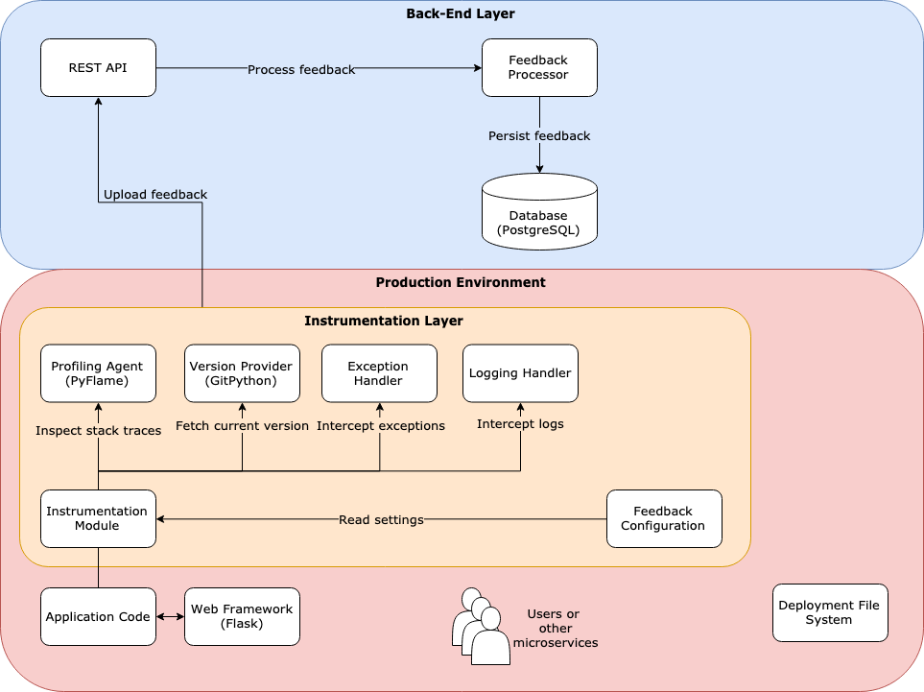
Architecture
Notes:
The metric backend is the second layer of our feedback framework. We receive raw production metrics from the instrumentation module. We then process that feedback and persist it to a timeseries database, that allows us to optimally store such information for later retrieval by the IDE plugin.
One of the goals of this project was to not just create a system that would work for Python and Flask, but also one that would generalize easily to other languages and frameworks. The way that this is currently architected is that intead of writing the client code for this rest API ourselves, we actually automatically generate it from a yaml file, using a technology called OpenAP that allows you to generate client code for almost any major language. This means that if we ever want to create an instrumentation module for another language, we can save a lot of time by simply generating the client code for that language, and focus on porting the instrumentation logic instead.
If we want to stick with Python and port to another web framework, say Django, then this becomes even easier, as all we have to do is change the Flask-specific API calls to the ones Django uses- the profiler, exception handler and logging handler can stay identical as we’re still inside Python world.

Slide 17
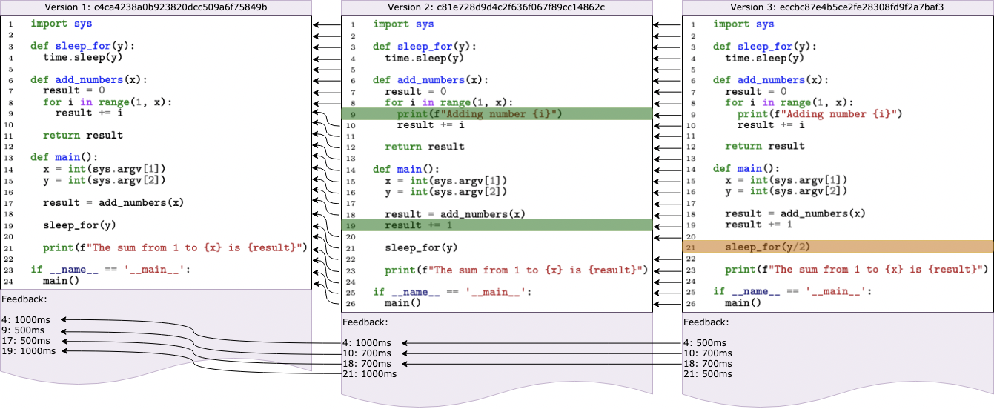
Feedback translation
Notes:
Another mechanism which was developed during the project is what I’ve decided to call feedback translation.
Take a look at this diagram. It shows three different versions of a file. Between version 1 and 2, we’ve added two lines, highlighted in green. Between version 2 and 3 we’ve modified a line, highlighted in orange. As the application code changes, and we start inserting, deleting or modifying lines, we change the places where feedback is instrumented.
For example, in the 1st and oldest version of the application, we may collect feedback on lines 4, 9, 17 and 19. In version two however, those same lines may no longer be in the same positions, because we’ve inserted two lines and shifted their positions. Our instrumentation layer reports feedback on a line-by-line basis, which means that in order to obtain a unified view of thesemetrics, we must somehow reconcile these multiple versions of feedback, collected on different lines in the file.
In order to do this, we perform what I’ve decided to call feedback translation, which enables us to reconcile different versions of feedback from logically similar lines. What do we mean by logically similar lines? In this case, the approach I’ve taken is to defined two lines to be logically similar if and only if they have the exact same textual contents. In order to do this, I apply a textu al difference algorithm beween any two consecutive versions of a file, in order to obtain a series of translations maps between every instrumented version of the application. For example, we start from the latest version, version 3. By applying the textual difference algorithm, we obtain a map from the current line number of each line to the line number of where that same line existed in the previous version. We continue this process back up to N times, where N is a configurable parameter, and reconcile the feedback collected for each particular line. For example, take a look at line 18 of this program. It represents a call to the add_numbers function which simply computes a sum of numbers from 1 to n. In the previous version, this line was also line 18, however in the version before that, it existed on line 17. That means that the output of the profiler, the output of any exceptions instrumentation as well as any logging calls will be different depending on the version under which this information was collected. This mechanism of feedback translation then allows us to follow these translation maps and unify the feedback collected for this add_numbers call. This is a crucial feature which allows us to display a unified performance history for how the behavior of this one particular line of code has changed across versions.
We also implicitly append a final version, which represents the dirty uncommitted changes that the developer has currently made to the file. This gives us the added bonus of being display feedback in the right places, even while the developer edits the file. So not only can we display a unified history of per-line metrics, but we can also seamlessly support live code editing alongside feedback display.

Slide 18
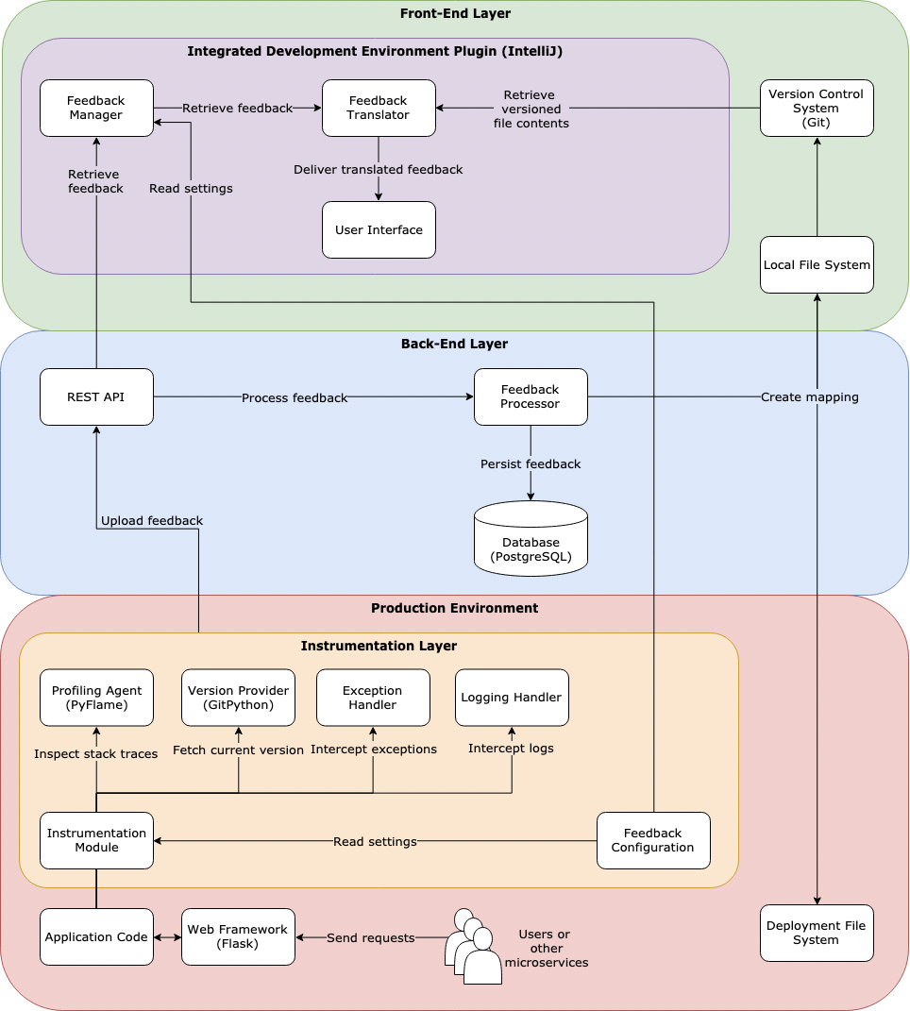
Notes:
Where does this process of feedback translation happen?
Well, it actually happens inside the third and final layer of our feedback framework, which is the IDE plugin developed using the IntelliJ platform.
There’s a few things worth noting here. The IDE plugin sits in the develper’s local environment. This means that we have to create a mapping between the local file system that their source files reside on, and the production file system where the application actually runs. This is because the output of the profiler, any exception instrumentation as well as any logging calls is collected from the production file system. We do this with the help of a feedback configuration file which specifies a base path in the project, that both the instrumentation layer and IDE plugin are aware of, and can therefore relativse the paths of the files against this same common base.
Another thing to note is that we have a local git installation sitting in the local environment too, which provies versioned file contents to our feedback translator, which eventually delivers translated feedback to the user interface.

Slide 19
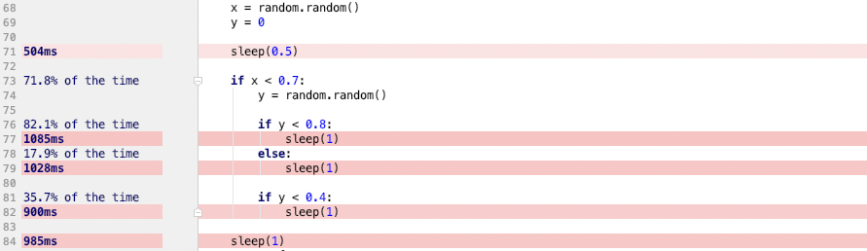
Branch execution probabilities
Notes:
Another big advantage in this system over any existing dashboard-based tooling is that modern IDEs provide plugins with really good AST manipulation capabilities. We are able to, for example, scan the whole file for any if statements, inspect the structure of the AST around those if statement, and infer completely new, derived forms of feedback which APM tools do not currently provide.
Our novel application of this was the estimation of branch execution probabilities. Due to our request-centric approach, any such request represents the execution of only certain portions of business logic. Because of our continuous profiling instrumentation, we actually know what parts of the program were touched during any such execution trace. Using this information, we estimate the branch execution probability of any if statement present in the program. The challenge in doing this correctly was due to the fact that the profiler is not guaranteed to always instrument a particular line, because the profiling process is non-deterministic. Therefore, we take measures to maximise our confidence in these estimates using various derivations that I’ve listed in the report. For example, imagine an if statement without an else branch: in order to accurate determine how many times we executed this if-statement, we actually first need to know how many times we’ve encountered that if statement, which involves looking at the parent scope for any execution traces there.

Slide 20
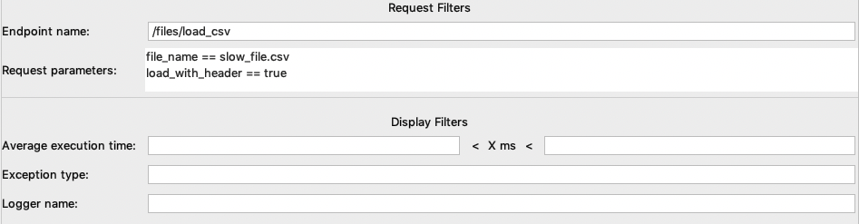
Feedback dimensions
Notes:
Lastly, I want to talk a little bit about feedback dimensions and the support that this tool has for those.
As the execution of our application is going to depend highly on the inputs that the application was given, we must some

Slide 21


Discussion

Slide 22
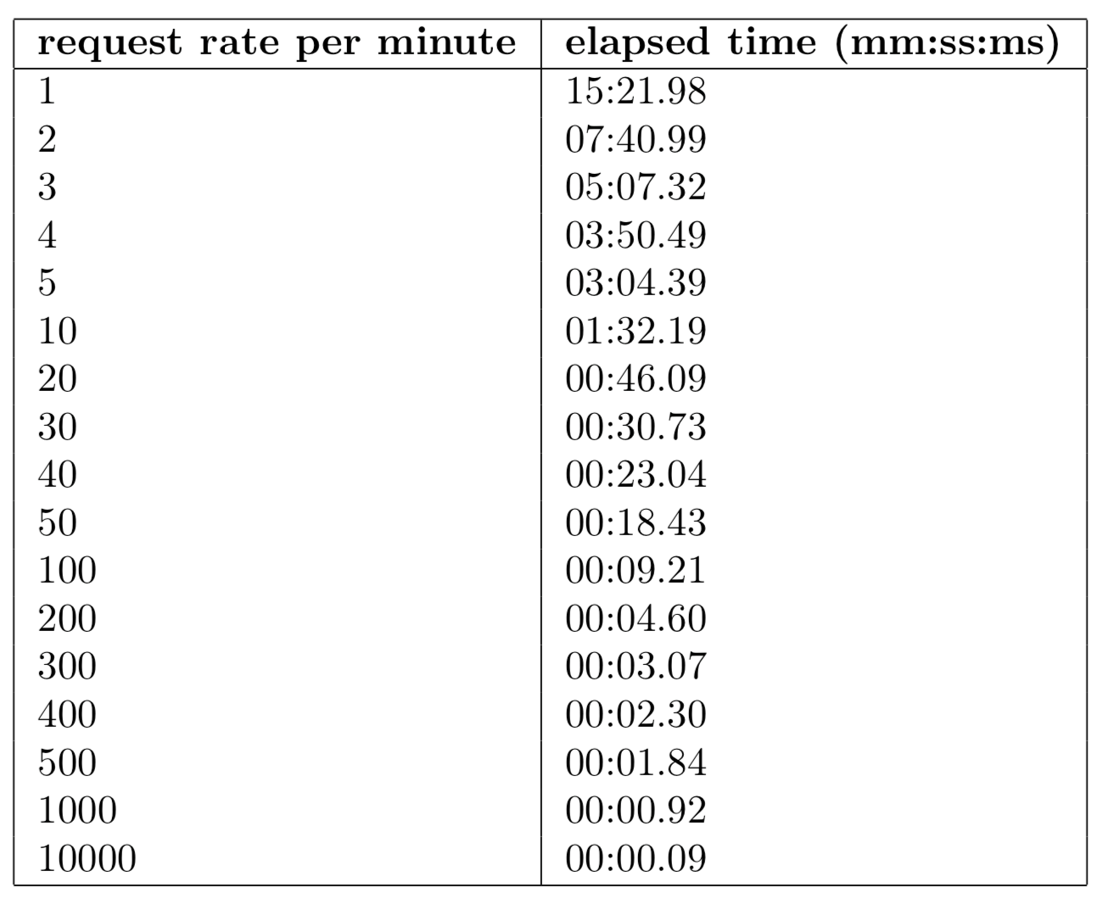
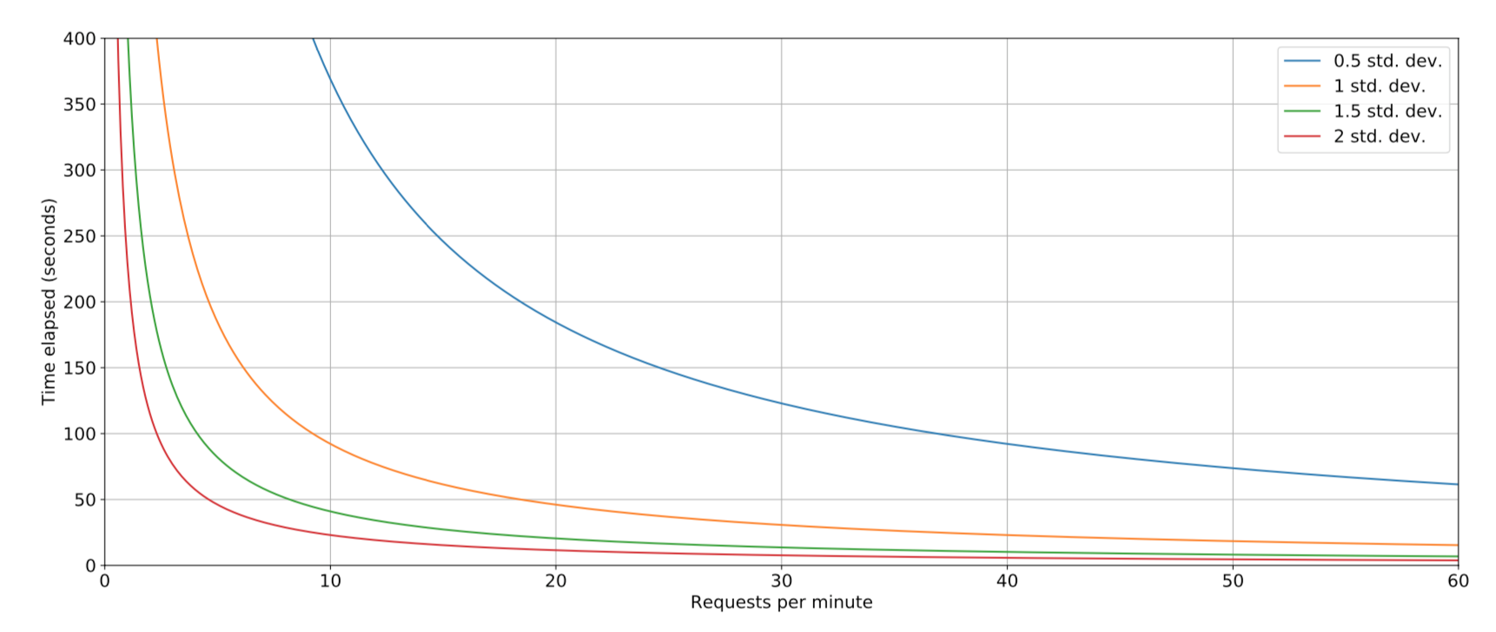
Request rates

Slide 23
Limitations
Overheads
External factors
Notes:
The consideration of such effects was left out partly by design. The proposed framework operates under the core assumption that providing developers with a true picture of how their application behaves in production is more useful during software maintenance tasks, which means that such external effects should also be visible. However, one can imagine a situation where a particularly contested machine causes various slowdowns on different parts of the instrumented application, which would be flagged as performance regressions by the IDE plugin. This may mislead the developer into thinking that an problem has arisen with the application code, and time could be wasted investigating an issue which is fixed only by allocating more capacity to existing compute nodes.
It is proposed that the combination of an always-on instrumentation layer designed to instru- ment every request, as well as the versioning of feedback, solve this problem somewhat. With a high enough request rate, any temporary spikes in performance figures would be averaged-out, such that the effect of the resultant skew is minimised. The versioning of feedback also helps with this, because whenever such external effects are displayed in the IDE, they are displayed with the associated version boundaries, for example, by overlaying lines inside the performance history graph to indicate when version have been deployed. Since no application logic can change within such version boundaries, the developer can be relatively confident that the resulting spikes are due to a rise in machine load rather than a problem with the code. This confidence is reduced when spikes are a result of the arrival of new, previously-unseen requests with new parameters that have adversely affected performance.

Slide 24
Result
Granular, versioned, code-centric metrics
No manual instrumentation
Real production environment
Immediate, actionable feedback directly in the IDE
Notes:
The benefits of this approach over existing tooling is the following.
We get granular, code centric metrics. Performance, exceptions and logging feedback is mapped directly over lines of code, which is what developers actually care about, rather than the coarse-grained, higher-level information displayed in existing tooling
We also didn’t need to manually invoke any instrumentation – the metrics displayed are being continuously collected from the running application as new requests come in
This application is running inside a real production environment, so as developers we have increased confidence in the collected metrics validity
And finally, very soon after we push any code changes, we can see actionable feedback directly in the IDE, and either continue working on fixing the issue, or be confident that the issue is indeed fixed
Modern development teams often aim for continuous delivery of new software. Systems are frequently updated and evolved, with small changes being deployed to production every day. These production systems can be a gold mine of data on how the system is operating. While application performance management (APM) tools are now commonly used in industrial practice to record such data, often in very large quantities, this is often in the realm of an operations team. To support a \emph{DevOps} culture, we see a need to gather data from production and present it to developers within their regular development environment, in a context-sensitive way. When a developer is working on a particular piece of code, we want to tell them how that particular piece of code is currently behaving in production. We argue that this offers many developer-centric benefits; among these is faster detection of performance and correctness regressions, enabling fast feedback loops to exist, increasing the developer's overall effectiveness in completing software maintenance tasks.
done X Y and Z, which wasn't done before
presented at conference
prioritise discussion over request parameters
anomaly detection in future work

Slide 25
Future work
Try-catch exceptions
More instrumentation data
Loop execution counts
PyFlame optimizations
Support request body
Code inspections
Notes:
Try-catch exceptions: predicting how many times we catch an unhandled exception
More instrumentation data: cloud costs
Count loop executions using logging lines
Optimize overheads
Request body

Slide 26
ICSE: http://www.continuous-se.org/2019/
Blog Post: https://medium.com/faun/ide-first-application-metrics-to-provide-actionable-feedback-for-developers-d17a83af19c0
GitHub: https://github.com/Norbo11/feedback_driven_development
Notes:
An earlier version of the the proposed feedback framework was presented at the 5th International Workshop on Rapid Continuous Software Engineering in conjunction with ICSE 2019, Montreal, Canada, May 27, 2019.
Self-contained demonstration in the blog post
Github link

Slide 27
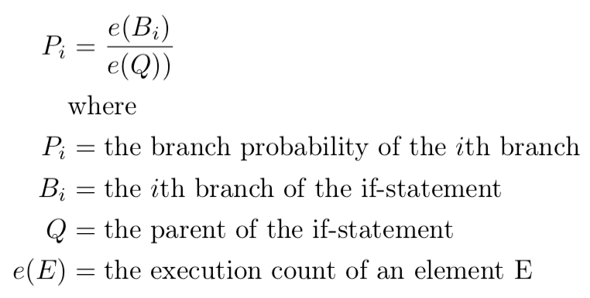
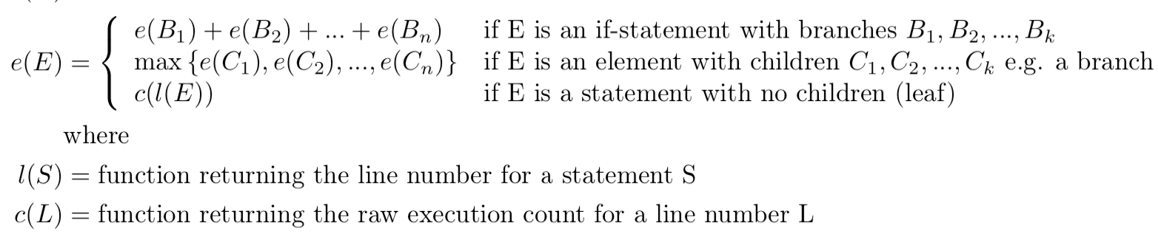
Backup slides

